Slide 1
Introduction to our data
The input provided consisted of two excel sheets containing the data of employees who have left the company and the existing employees respectively.
There were no null/missing values in the data.
Ex-employee dataset had 11428 rows and 10 columns.
Existing employee dataset had 3571 rows and 10 columns.
Categorical variables: Salary and Departments.
Rest of the 8 columns had numeric values.

Slide 2
Understanding the Variables
Emp ID: It is an indexing variable, which can uniquely identify every row of the dataset, but has no major role in data analysis.
satisfaction_level: The variable describes the level of employee satisfaction.It ranges from 0 to 1.
last_evaluation: It is a measure of employee performance and ranges from 0 to 1.
average_monthly_hours: What’s the average number of hours the employee worked for the company during a month.
time_spend_company: Variable denotes the number of years an employee has worked for the company.

Slide 3
Work_accident: Wheather had an employee had a work accident or not.
promotion_last_5years: Indicates wheather the employee has got any promotion in the last 5 years or not.
dept: The department to which the employee belongs.E.g:sales,marketing,etc.
Salary: Gives information about the level of salary: low,medium and high.

Slide 4
Analysis with Excel
With exploratory analysis with excel I made a pivot table to analyse the data of the employees and underline,some of the factors on basis of some common sense along with the numbers.
Inferences drawn involved:
Only 19 out of 3571 of the ex-employees and 300 out of 11428 existing employees got promoted after 5 years of their service in the organization.Thus it can be a decisive factor.
2172 of the 3571 ex-employees and 5144 of 11428 existing employees had low salary levels while 1317 of the ex-employees and 5129 existing employees had medium level salary.
Sales department has the highest number of existing as well as ex- employees.
The 3years working period appears to be crucial for most of the employees who might leave the company in search of better opportunities.

Slide 5
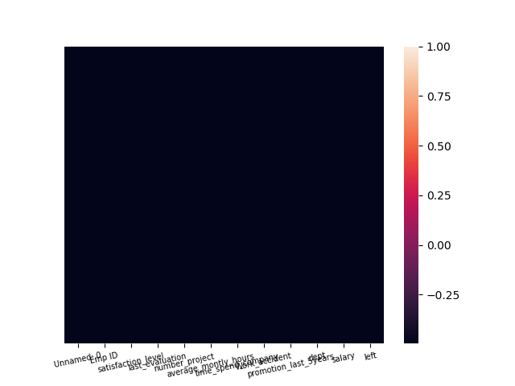
Visualizations
Check for null values:
The dataset is checked for any null values using a heatmap.The heatmap on the right clearly indicates that there are no missing values in our dataset.Therefore we can proceed further.

Slide 6
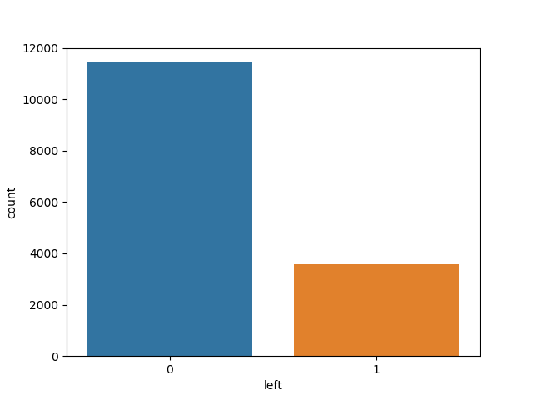
Employee Distribution
The employee distribution helps us to visualize that what’s the ratio of the employees who are working in the organization and those who left.

Slide 7
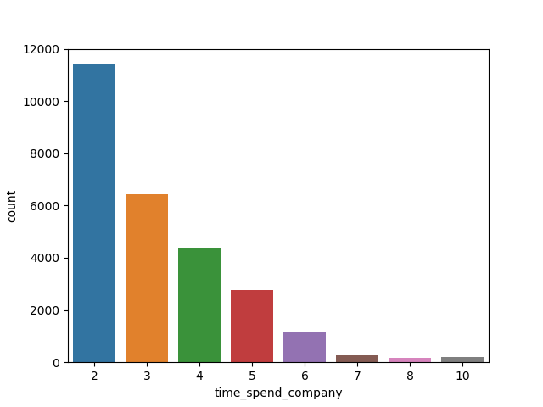
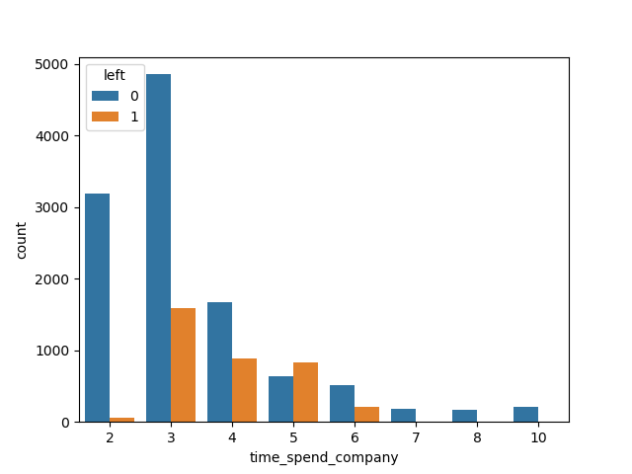
Time_spend
From the countplot shown, we can infer thet there is a large gap between the number of employees with 2 years of experience in the company and that of employees with 3 years of experience.
Also from the second plot we can infer that an employee is not likely to leave the company after working for 6 years or more.

Slide 8
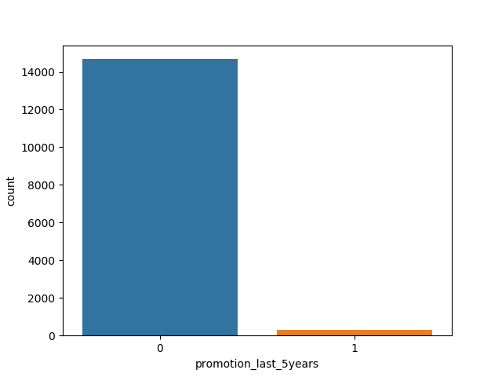
Promotion
Countplot again proves to be useful in visualizing the number of promotions.
As inferred from excel only 319 employees from combined dataset, got a promotion in last 5 years.

Slide 9
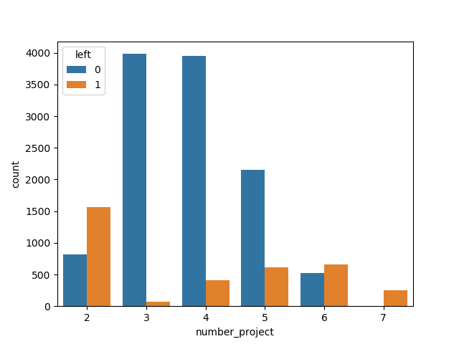
Number_project
From the the plot we can infer that employees who did more than 5 projects are more likely to leave the company,mostly those who have done about 6 to 7 projects as there the bar of employees who left is even higher than those who stayed dspite of such a large difference in population of these sets.

Slide 10
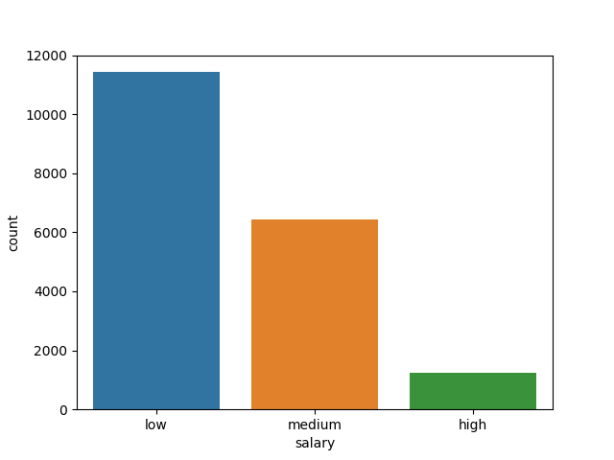
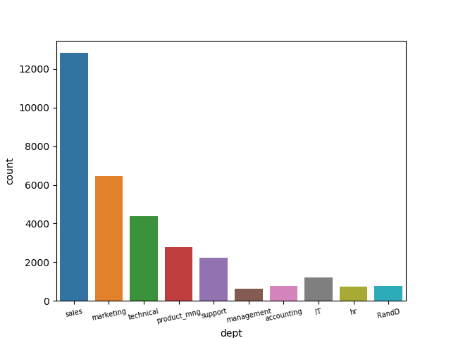
Salary and dept
From the count plots, it is inferred that most of the employees who left were from sales department. Also most of the employees had low salary levels.

Slide 11
Summary of visualizations.
Time_spend_company is one of the strongest contributors to job attrition as there was a huge gap between 2 and 3 years employees and employees who have worked for 6 or more years in the company are not likely to leave,probably due to their affection toward the organization.
Number_of_project is also expected to affect the regression model, after time_spend.
Salary and promotion_last_5years are also likely to affect attrition according to visualisation as it was skewed, but when we perform correlation analysis it is found that promotions were very weakly correlated with attrition. Also, salary will not affect attrition to the extent it was expected to.
The correlation data is stored in takenmind.xlsx file and correlation map is also attached in the plot folder submitted.

Slide 12
Building the Model
Data cleaning: As our data does not have ambiguities like null or missing values we can skip this step.
Removal of categorical variables: We remove categorical variables of salary and department and mapped their values with dummy variables in form of 0 and 1.
Split columns in x and y: The left variable is the dependent y variable and rest of the columns are taken in independent variables set.
It is to note that we could have removed weakly or very strongly , correlated variables but as this is the final model I have considered all factors.

Slide 13
Split the data into training and testing datasets: I have divided the the dataset in a 30:70 ratio for the same.
Trained the model fitted it on x_train set.
Predictions are made on x_test and accuracy was analysed with accuracy_score function and confusion matrix.

Slide 14
Results
The regression model offers a accuracy score of 0.796 with an f1 score of 0.88.
Employees who have spend 2 years in the company are likely to leave the company around the 3rd year mark.
Employees who have worked on 6 to 7 projects are likely to leave the company.
Employees with low salaries are also prone to leave the company in future,probably for better opportunities elsewhere.
Time_spend_company and number_project are the major contributors towards attrition followed by average_montly_hours(due correlation) and salary(visualization and affects model accuracy by 1%).

Slide 15
Thank You

